Slide 1
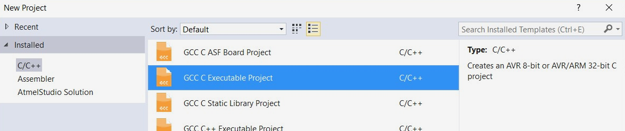
C Project
Ensure you select the ‘GCC C Executable Project’ type
This will matter in next weeks lab as we start to interface with more complex subsystems of the lab board
Notes:
Just in case I’ve told you all to use the C++ libraries!
From next week, this WILL matter!!

Slide 2
Setting ADC Registers
ADCSRA
  Enables functionality of the ADC
  Gives us a flag for checking to see when a conversion is complete
ADCSRB
  Sets High Speed Mode and Auto Trigger source
  For now, don’t worry about this register (it’s default values are fine!)
ADMUX
  Selects the voltage reference for the ADC
  (Use AVCC – Bit7:6 = 11)
  Selects the Left-Adjust for the ADC data – Enable this – Bit 5 = 1
  Selects the ADC channel/pin for checking – Bits 4:0 set depending on ADC input
Notes:
The ADC is 10-bit, left-adjusting allows us to review the most significant bits!

Slide 3
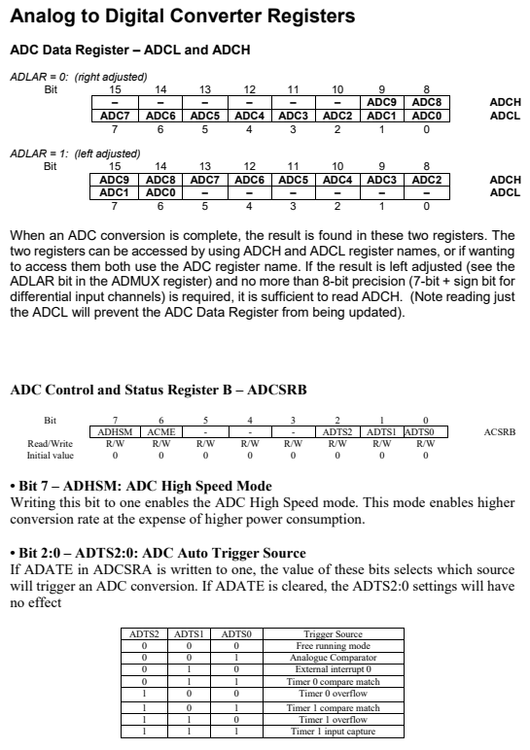
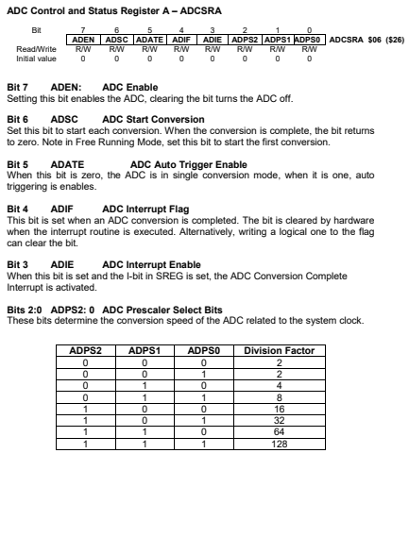
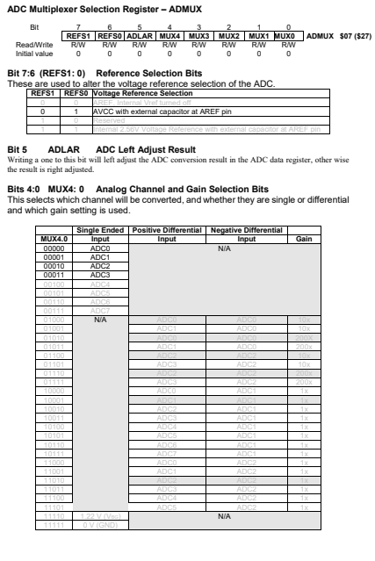
Setting ADC Registers
Notes:
Pages 2 – 4 in your Microcontroller Register Reference Guide

Slide 4
Obtaining ADC Values for Single-Conversion
Use a function to return the value of the ADC
  The example to the right is also used extensively in your textbook.
Define the ADC input by passing ADMUX as the channel parameter
  For each ADC input, define a separate ADMUX value
  In the example to the left, getADC3 and getADC2 have been defined as the values for the ADMUX register for the respective ADC input
// The readADC function recommended
#define startConversion ADCSRA |= (1<<ADSC)
#define conversionRunning ADCSRA & (1<<ADSC)
#define getADC3 0b01100011
#define getADC2 0b01100010
char readADC(char channel)
{
// Setup the appropriate ADC channel
ADMUX = channel;
// Starts a single conversion
startConversion;
// Do nothing until the conversion is
complete
while(conversionRunning);
// Return the ADC value
return(ADCH);
}

Slide 5
Setting up VR1
MIC
RH
UART
ETH
We will be using a Variable Resistor (VR1)
  AKA ‘POT1’ on the Lab Board
Ensure that the selector switch is set to POT1 and not MIC
  Locate this under the seven-segment displays
  This switch tells us that this input is shared between the Microphone and Variable Resistor 1
POT1
POT2
LOOP
USB
PC3
PC2
PC1
PC0

Slide 6
Setting ADC Registers Example – Problem 2
As we need to switch between two ADC sources, we need to operate in the single-conversion mode
Setup ADCSRA
  Enable ADC – Bit 7 = 1
  We don’t want to start a conversion right away – Bit 6 = 0
  We want to operate in single-conversion mode – Bit 5 = 0
  We are not using interrupts (for now) – Bit 4 & 3 = 0
  We will be using the largest pre-scaler (128) – Bit 2:0 = 111
Setup ADCSRB
  We don’t need to worry about this register, as the default values are correct.
// Setup ADC for single-
conversion mode
void setup(void) {
ADCSRA = 0b10000111;
}

Slide 7
Setting ADC Registers Example – Problem 5
We have a single ADC source. Hence, we can use the auto-trigger mode to save us calling readADC()
Setup ADCSRA
  Enable ADC – Bit 7 = 1
  We want to start the operation of the free-running mode – Bit 6 = 1
  We want to operate auto-trigger mode – Bit 5 = 1
  We are not using interrupts (for now) – Bit 4 & 3 = 0
  We will be using the largest pre-scaler (128) – Bit 2:0 = 111
Setup ADCSRB
  We don’t need to worry about this register, as the default values are correct.
Setup ADMUX
  Since we are running in continuous-conversion mode, setup the ADMUX here!
// Setup ADC for auto-
trigger
void setup(void) {
ADCSRA = 0b11100111;
ADCSRA = 0b01100001;
}

